Slide 1
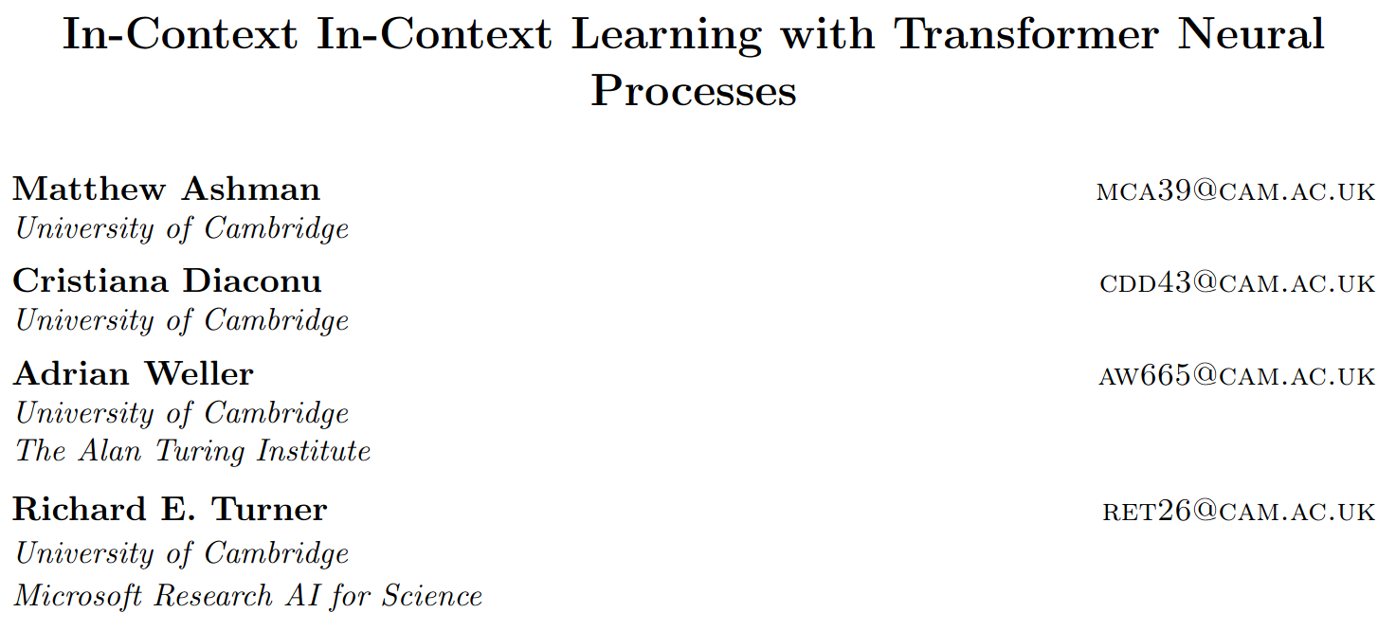
July 2024

Slide 2
Neural Processes

Slide 3


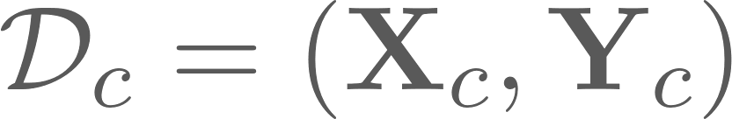

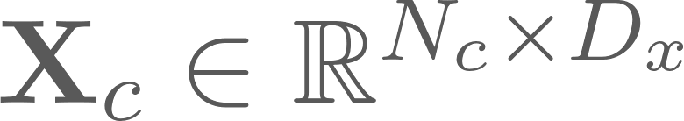

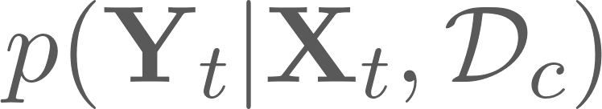

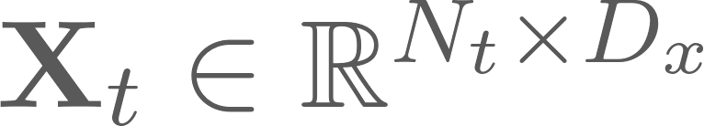


Meta Learning Setting
Seek to approximate the posterior predictive map of a ground-truth -valued stochastic process on input space
Given a dataset of context datapoints, where
approximate for target inputs
We want our model to be
Invariant to permutations of and
Able to deal with an arbitrary number of datapoints and
(so we might consider a transformer-based model…)

Slide 4
Meta Learning Setting
Seek to approximate the posterior predictive map of a ground-truth -valued stochastic process on input space
Given a dataset of context datapoints, where
approximate for target inputs
We want our model to be
Invariant to permutations of and
Able to deal with an arbitrary number of datapoints and
(so we might consider a transformer-based model…)

Slide 5
Meta Learning Setting
Seek to approximate the posterior predictive map of a ground-truth -valued stochastic process on input space
Given a dataset of context datapoints, where
approximate for target inputs
We want our model to be
Invariant to permutations of and
Able to deal with an arbitrary number of datapoints and
(so we might consider a transformer-based model…)

Slide 6
Meta Learning Setting
Seek to approximate the posterior predictive map of a ground-truth -valued stochastic process on input space
Given a dataset of context datapoints, where
approximate for target inputs
We want our model to be
Invariant to permutations of and
Able to deal with an arbitrary number of datapoints and
(so we might consider a transformer-based model…)

Slide 7
Meta Learning Setting
Seek to approximate the posterior predictive map of a ground-truth -valued stochastic process on input space
Given a dataset of context datapoints, where
approximate for target inputs
We want our model to be
Invariant to permutations of and
Able to deal with an arbitrary number of datapoints and
(so we might consider a transformer-based model…)

Slide 8






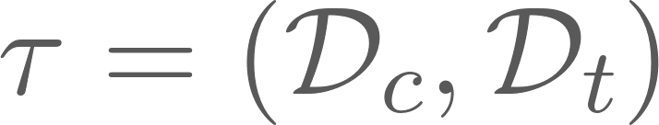
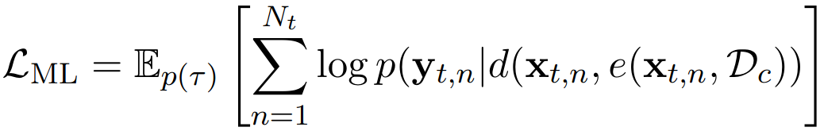
Neural Processes (NPs)
Model using an encoder and a decoder
where:
is the set of all finite datasets ( )
is some latent space
is the parameter space of our predictive distribution.
Train by maximising the posterior predictive likelihood over tasks
(use a Monte-Carlo estimate of this expectation using the tasks you actually have access to)

Slide 9
Neural Processes (NPs)
Model using an encoder and a decoder
where:
is the set of all finite datasets ( )
is some latent space
is the parameter space of our predictive distribution.
Train by maximising the posterior predictive likelihood over tasks
(use a Monte-Carlo estimate of this expectation using the tasks you actually have access to)

Slide 10
Neural Processes (NPs)
Model using an encoder and a decoder
where:
is the set of all finite datasets ( )
is some latent space
is the parameter space of our predictive distribution.
Train by maximising the posterior predictive likelihood over tasks
(Use a Monte-Carlo estimate of this expectation using the tasks you actually have access to.)

Slide 11
2. Transformer Neural Processes

Slide 12
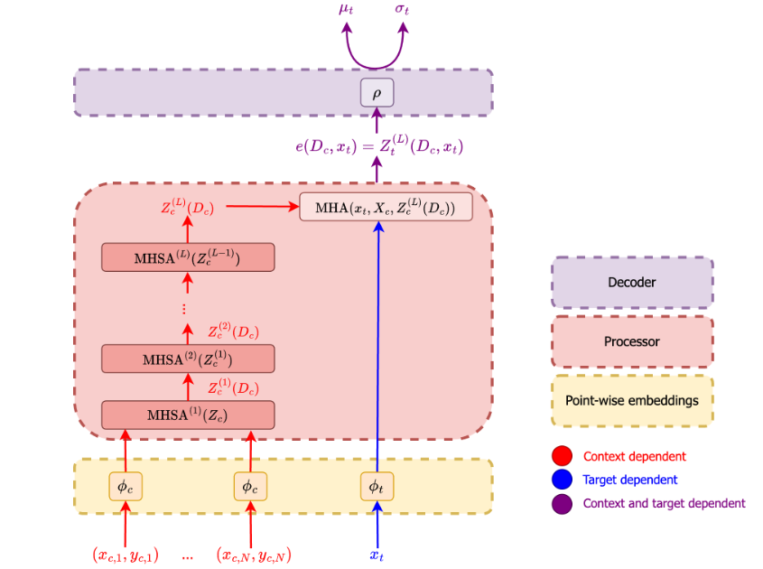
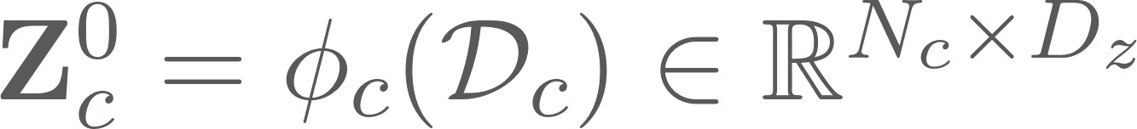



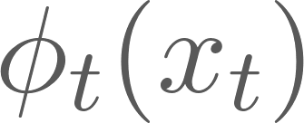

Transformer Neural Processes (TNPs)
Obtain initial token representation for context points via pointwise embeddings
Pass tokens through multi-headed self-attention layers
Perform cross attention with
Values
Keys
Queries
Pass output through decoder (a 2-layer, 128-width MLP) to get predictive distribution (mean and variance of a Gaussian).
(Attentive Neural Process, Kim et al., 2019)

Slide 13
Transformer Neural Processes (TNPs)
Obtain initial token representation for context points via pointwise embeddings
Pass tokens through multi-headed self-attention layers
Perform cross attention with
Values
Keys
Queries
Pass output through decoder (a 2-layer, 128-width MLP) to get predictive distribution (mean and variance of a Gaussian).
(Attentive Neural Process, Kim et al., 2019)

Slide 14
Transformer Neural Processes (TNPs)
Obtain initial token representation for context points via pointwise embeddings
Pass tokens through multi-headed self-attention layers
Perform cross attention with
Values
Keys
Queries
Pass output through decoder (a 2-layer, 128-width MLP) to get predictive distribution (mean and variance of a Gaussian).
(Attentive Neural Process, Kim et al., 2019)

Slide 15
Transformer Neural Processes (TNPs)
Obtain initial token representation for context points via pointwise embeddings
Pass tokens through multi-headed self-attention layers
Perform cross attention with
Values
Keys
Queries
Pass output through decoder (a 2-layer, 128-width MLP) to get predictive distribution (mean and variance of a Gaussian).
(Attentive Neural Process, Kim et al., 2019)

Slide 16
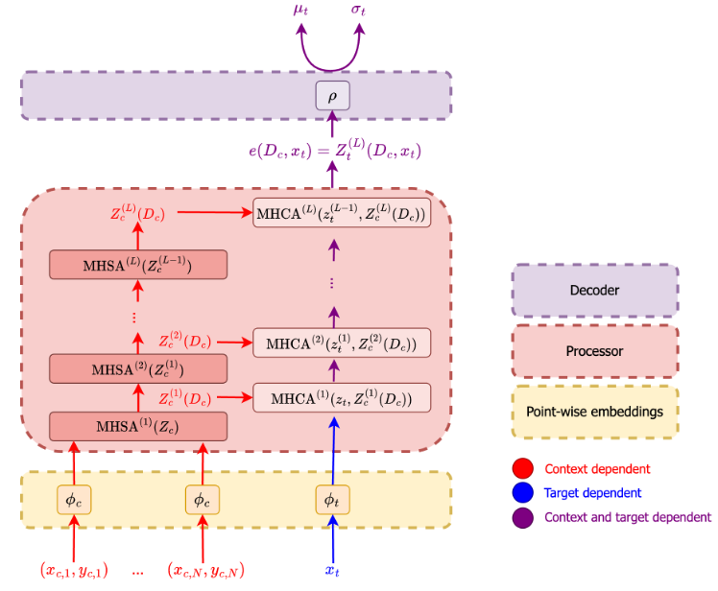

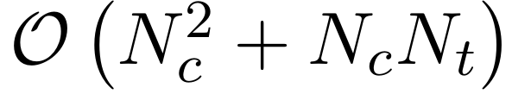
Transformer Neural Processes (TNPs)
Better idea: add in cross-attention between context tokens and updated target token at each layer
Problem:
Solution: pseudo tokens
(Transformer Neural Process, Nguyen and Grover, 2022)

Slide 17
Transformer Neural Processes (TNPs)
Better idea: add in cross-attention between context tokens and updated target token at each layer
Problem:
Solution: pseudo tokens
(Transformer Neural Process, Nguyen and Grover, 2022)

Slide 18
Transformer Neural Processes (TNPs)
Better idea: add in cross-attention between context tokens and updated target token at each layer
Problem:
Solution: pseudo tokens
(Transformer Neural Process, Nguyen and Grover, 2022)

Slide 19
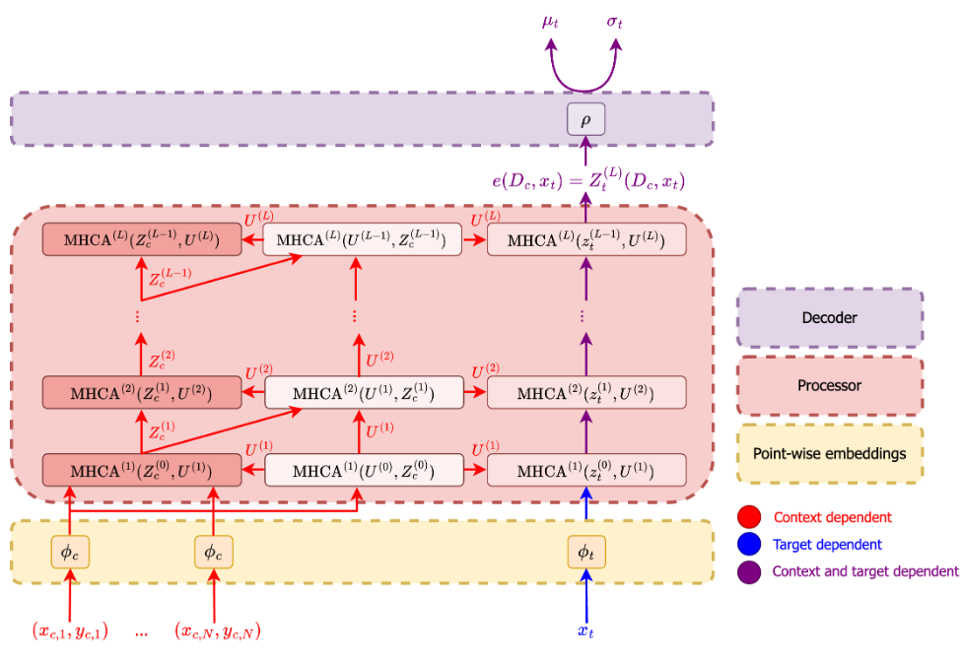

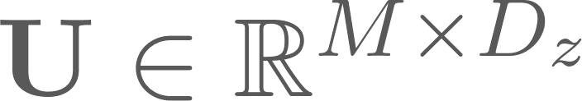
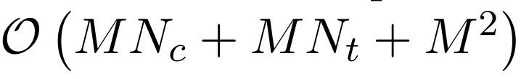
Pseudo Token TNP (PT-TNP)
Add in ‘pseudo tokens’, , to distill/summarise the latent context tokens, .
Remove the quadratic cost of performing attention between and tokens
Now we’re linear in dataset size
(Set Transformer, Lee et al., 2019)

Slide 20
Pseudo Token TNP (PT-TNP)
Add in ‘pseudo tokens’, , to distill/summarise the latent context tokens, .
Remove the quadratic cost of performing attention between context and target
Now we’re linear in dataset size
(Set Transformer, Lee et al., 2019)

Slide 21
Pseudo Token TNP (PT-TNP)
Add in ‘pseudo tokens’, , to distill/summarise the latent context tokens, .
Remove the quadratic cost of performing attention between context and target
Now we’re linear in dataset size
(Set Transformer, Lee et al., 2019)

Slide 22
3. In-Context In-Context Learning

Slide 23
What if we have related (‘in-context’) data?
We may have multiple related datasets from the target stochastic process
E.g. a meta-dataset of PDE-simulated Navier-Stokes equations*
Could be partitioned into multiple sets based on the Reynold’s number (dimensionless parameter describing fluid flow)
Infeasible: train one NP per Reynold’s number (from 10^-6 to 10^12)
Idea: learn a single NP that can condition on each partition of the meta-dataset
“In-context in-context learning”
“amortizing the learning of stochastic-process specific NPs”
(*) Note: training a single NP on the whole non-partitioned meta-dataset would give the predictive distribution of the marginal stochastic process

Slide 24
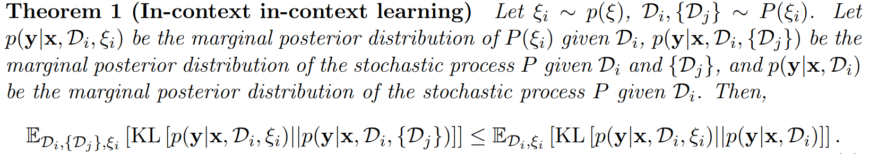




Theorem: More data is good
If we have extra datasets from the stochastic process (on top of ), then it can’t hurt to condition on those too.
We refer to the additional datasets as the in-context datasets

Slide 25
Theorem: More data is good
If we have extra datasets from the stochastic process (on top of ), then it can’t hurt to condition on those too.
We refer to the additional datasets as the in-context datasets

Slide 26
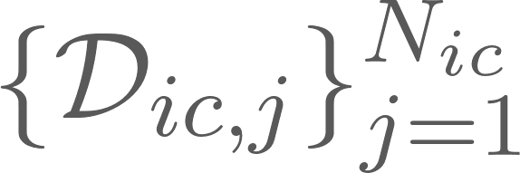
Theorem: More data is good
If we have extra datasets from the stochastic process (on top of ), then it can’t hurt to condition on those too.
We refer to the additional datasets as the in-context datasets

Slide 27
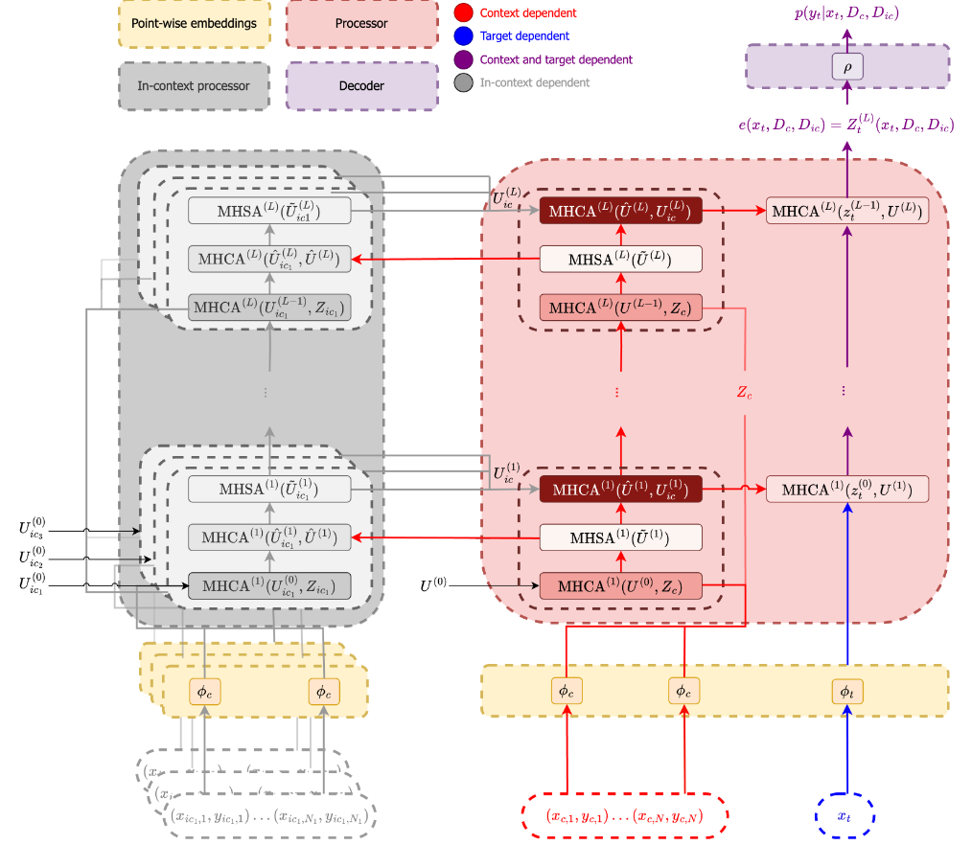





In-Context In-Context Learning with TNPs (ICICL-TNP)
Create extra pseudo-tokens for each of the in-context datasets, .
At each layer we perform cross attention:
Between latents (or ) and pseudo tokens (or )
Between context (i.e. regular) pseudo tokens and concatenated in-context pseudo tokens
Between target latents and pseudo tokens (as in regular PT-TNPs)
Basically, the in-context processor maintains in-context latents and in-context pseudo tokens which are used to modulate the main processor’s pseudo tokens

Slide 28
In-Context In-Context Learning with TNPs (ICICL-TNP)
Create extra pseudo-tokens for each of the in-context datasets, .
At each layer we perform cross attention:
Between latents (or ) and pseudo tokens (or )
Between context (i.e. regular) pseudo tokens and concatenated in-context pseudo tokens
Between target latents and pseudo tokens (as in regular PT-TNPs)
Basically, the in-context processor maintains in-context latents and in-context pseudo tokens which are used to modulate the main processor’s pseudo tokens

Slide 29
In-Context In-Context Learning with TNPs (ICICL-TNP)
Create extra pseudo-tokens for each of the in-context datasets, .
At each layer we perform cross attention:
Between latents (or ) and pseudo tokens (or )
Between context (i.e. regular) pseudo tokens and concatenated in-context pseudo tokens
Between target latents and pseudo tokens (as in regular PT-TNPs)
Basically, the in-context processor maintains in-context latents and in-context pseudo tokens which are used to modulate the main processor’s pseudo tokens

Slide 30
In-Context In-Context Learning with TNPs (ICICL-TNP)
Create extra pseudo-tokens for each of the in-context datasets, .
At each layer we perform cross attention:
Between latents (or ) and pseudo tokens (or )
Between context (i.e. regular) pseudo tokens and concatenated in-context pseudo tokens
Between target latents and pseudo tokens (as in regular PT-TNPs)
Basically, the in-context processor maintains in-context latents and in-context pseudo tokens which are used to modulate the main processor’s pseudo tokens

Slide 31
In-Context In-Context Learning with TNPs (ICICL-TNP)
Create extra pseudo-tokens for each of the in-context datasets, .
At each layer we perform cross attention:
Between latents (or ) and pseudo tokens (or )
Between context (i.e. regular) pseudo tokens and concatenated in-context pseudo tokens
Between target latents and pseudo tokens (as in regular PT-TNPs)
Basically, the in-context processor maintains in-context latents and in-context pseudo tokens which are used to modulate the main processor’s pseudo tokens

Slide 32
In-Context In-Context Learning with TNPs (ICICL-TNP)
Create extra pseudo-tokens for each of the in-context datasets, .
At each layer we perform cross attention:
Between latents (or ) and pseudo tokens (or )
Between context (i.e. regular) pseudo tokens and concatenated in-context pseudo tokens
Between target latents and pseudo tokens (as in regular PT-TNPs)
Basically, the in-context processor maintains in-context latents and in-context pseudo tokens which are used to modulate the main processor’s pseudo tokens

Slide 33
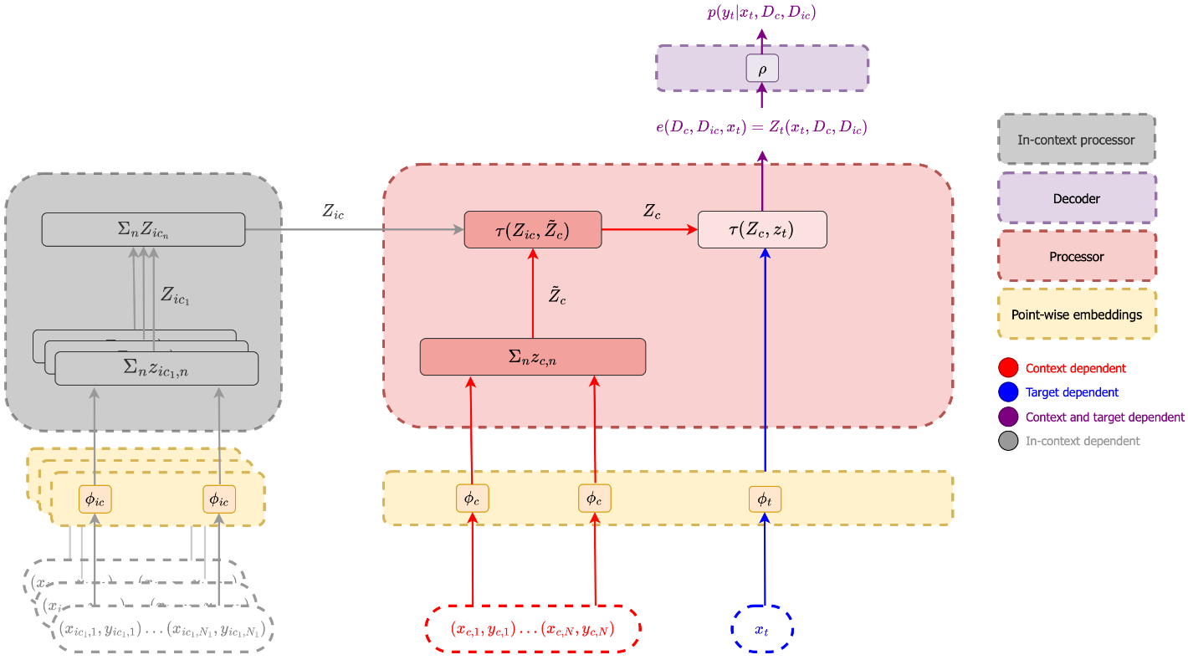
(Simpler model) ICICL Conditional Neural Processes (ICICL-CNPs)

Slide 34
4. Experiments

Slide 35
Experiments
Want to check:
Is ICICL still good without any in-context datasets?
Does ICICL get better with more in-context datasets (as we’d hope/expect)?
How does ICICL fare with OOD contexts?
How does ICICL fare with misspecified in-context datasets?

Slide 36
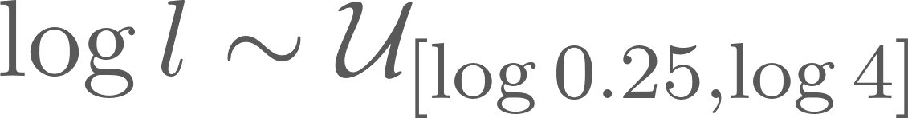
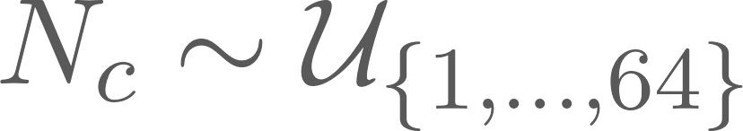
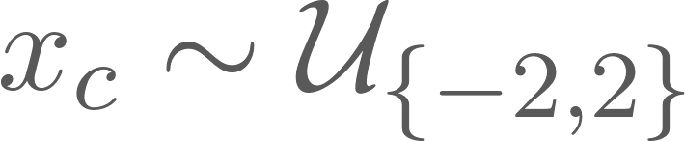

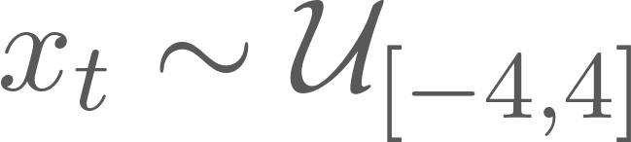
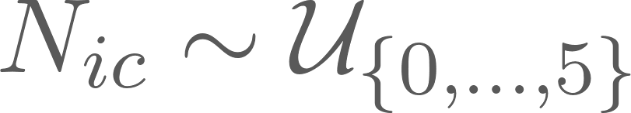
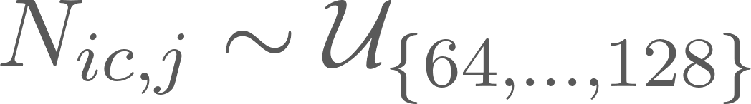
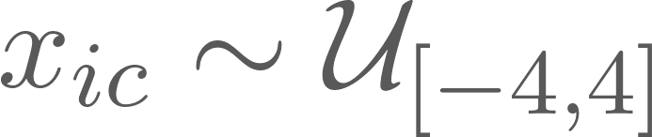
Synthetic 1D Regression
Draw samples from a Gaussian process with:
Kernel sampled from {RBF, periodic}
Bandwidth/period sampled from
context points at
target points at
in-context sets, each with points at
Observation noise 0.2
(In-context datasets are drawn using the exact same kernel as the context-dataset.)

Slide 37
Synthetic 1D Regression
Draw samples from a Gaussian process with:
Kernel sampled from {RBF, periodic}
Bandwidth/period sampled from
context points at
target points at
in-context sets, each with points at
Observation noise 0.2
(In-context datasets are drawn using the exact same kernel as the context-dataset.)

Slide 38
Synthetic 1D Regression
Draw samples from a Gaussian process with:
Kernel sampled from {RBF, periodic}
Bandwidth/period sampled from
context points at
target points at
in-context sets, each with points at
Observation noise 0.2
(In-context datasets are drawn using the exact same kernel as the context-dataset.)

Slide 39
Synthetic 1D Regression
Draw samples from a Gaussian process with:
Kernel sampled from {RBF, periodic}
Bandwidth/period sampled from
context points at
target points at
in-context sets, each with points at
Observation noise 0.2
(In-context datasets are drawn using the exact same kernel as the context-dataset.)

Slide 40
Synthetic 1D Regression
Draw samples from a Gaussian process with:
Kernel sampled from {RBF, periodic}
Bandwidth/period sampled from
context points at
target points at
in-context sets, each with points at
Observation noise 0.2
(In-context datasets are drawn using the exact same kernel as the context-dataset.)

Slide 41
Synthetic 1D Regression
Draw samples from a Gaussian process with:
Kernel sampled from {RBF, periodic}
Bandwidth/period sampled from
context points at
target points at
in-context sets, each with points at
Observation noise 0.2
(In-context datasets are drawn using the exact same kernel as the context-dataset.)

Slide 42
Synthetic 1D Regression
Draw samples from a Gaussian process with:
Kernel sampled from {RBF, periodic}
Bandwidth/period sampled from
context points at
target points at
in-context sets, each with points at
Observation noise 0.2
(In-context datasets are drawn using the exact same kernel as the context-dataset.)

Slide 43
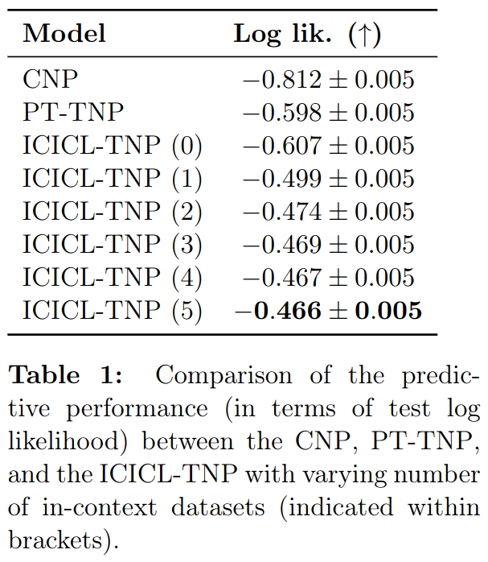
Synthetic 1D Regression
(CNP just uses MLPs instead of transformers.)

Slide 44
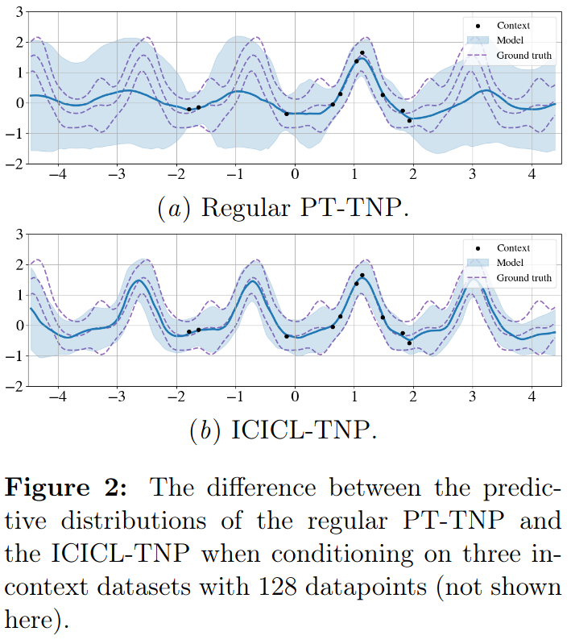
Synthetic 1D Regression

Slide 45
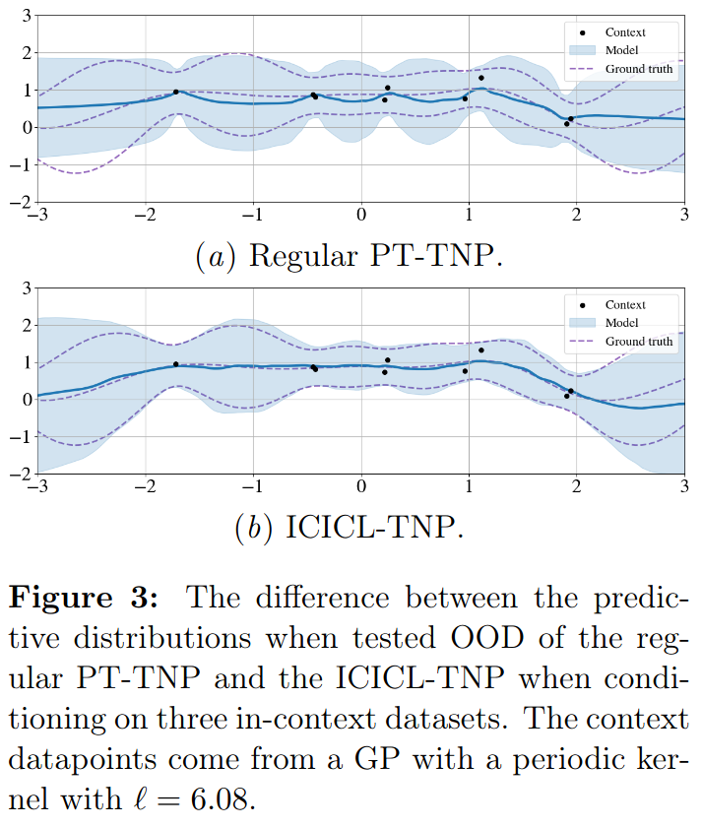
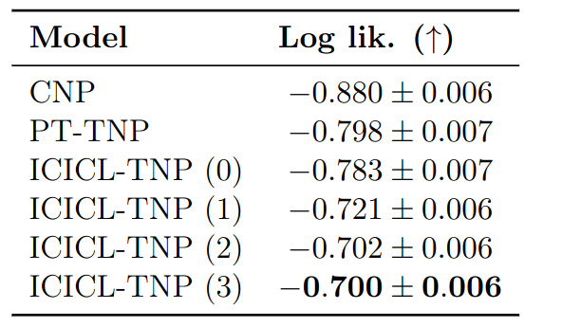
Synthetic 1D Regression - OOD
Test on datasets with bandwidth/period sampled as

Slide 46
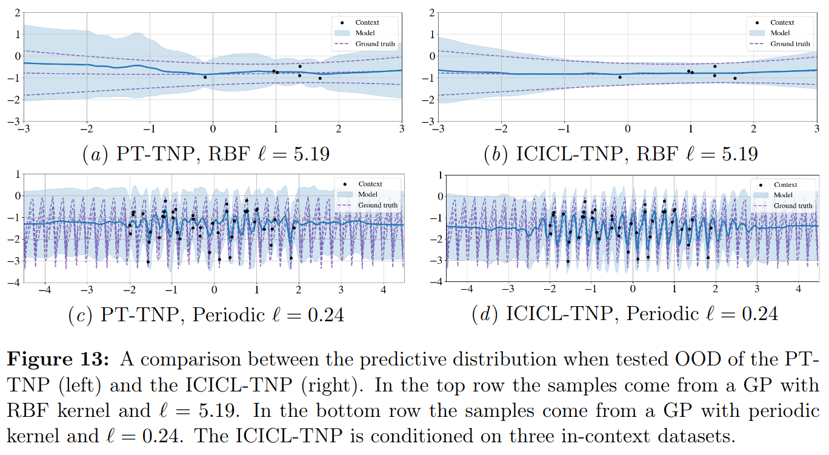
Synthetic 1D Regression - OOD

Slide 47
Synthetic 1D Regression - OOD

Slide 48
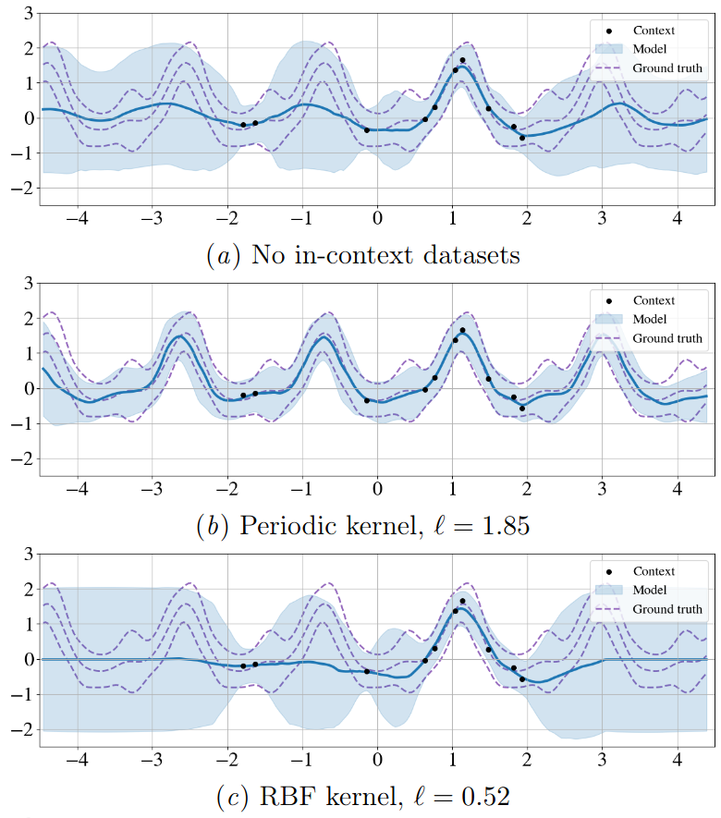
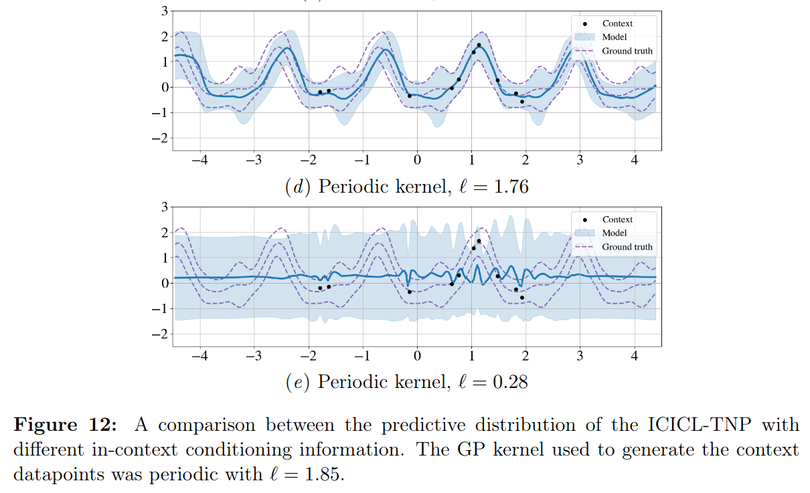
Synthetic 1D Regression - Incorrect In-context Conditioning

Slide 49
Synthetic 1D Regression - Incorrect In-context Conditioning

Slide 50
Synthetic 1D Regression - Incorrect In-context Conditioning

Slide 51
Synthetic 1D Regression - Incorrect In-context Conditioning

Slide 52
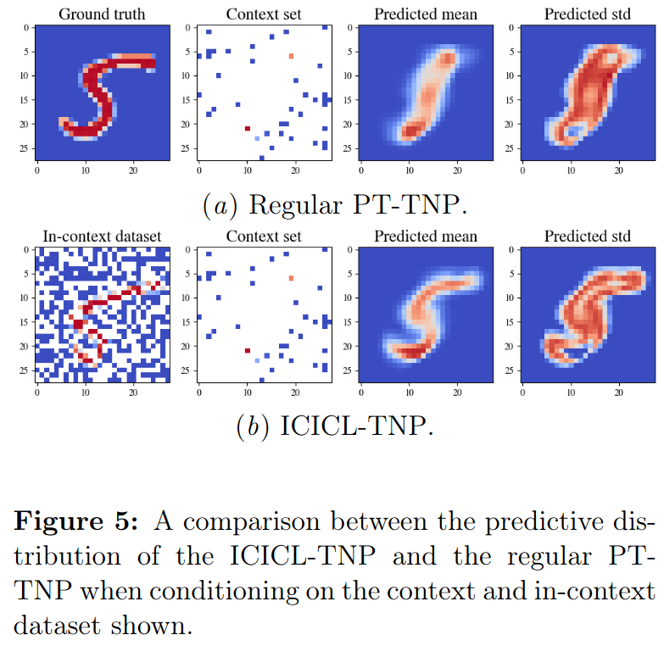

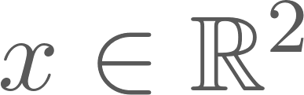

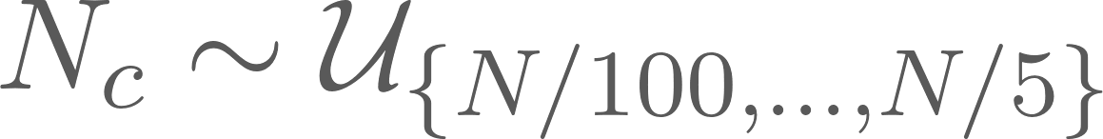
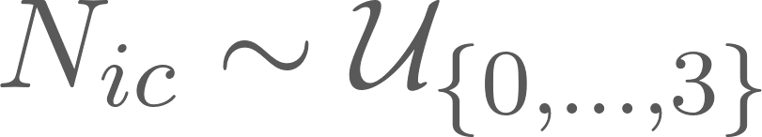
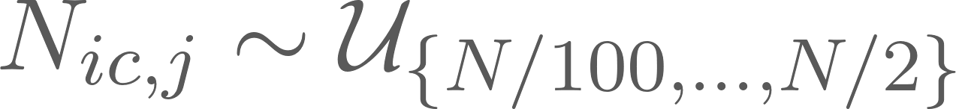

MNIST Image Completion
2D pixel locations
Pixel values
context points
in-context sets with
(In-context datasets are drawn using the same class label as the context-dataset.)

Slide 53
MNIST Image Completion
2D pixel locations
Pixel values
context points
in-context sets with
(In-context datasets are drawn using the same class label as the context-dataset.)

Slide 54
MNIST Image Completion
2D pixel locations
Pixel values
context points
in-context sets with
(In-context datasets are drawn using the same class label as the context-dataset.)

Slide 55
MNIST Image Completion
2D pixel locations
Pixel values
context points
in-context sets with
(In-context datasets are drawn using the same class label as the context-dataset.)

Slide 56
MNIST Image Completion
2D pixel locations
Pixel values
context points
in-context sets with
(In-context datasets are drawn using the same class label as the context-dataset.)

Slide 57
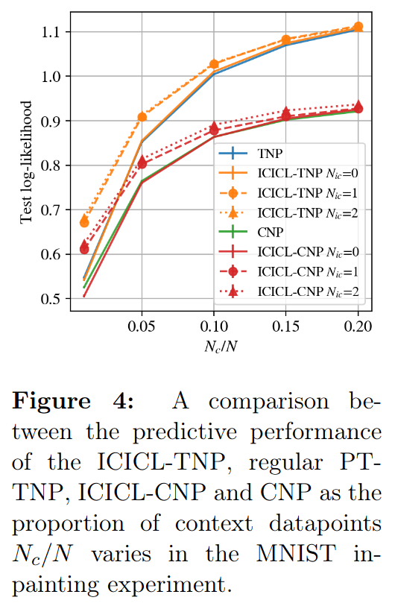
MNIST Image Completion

Slide 58
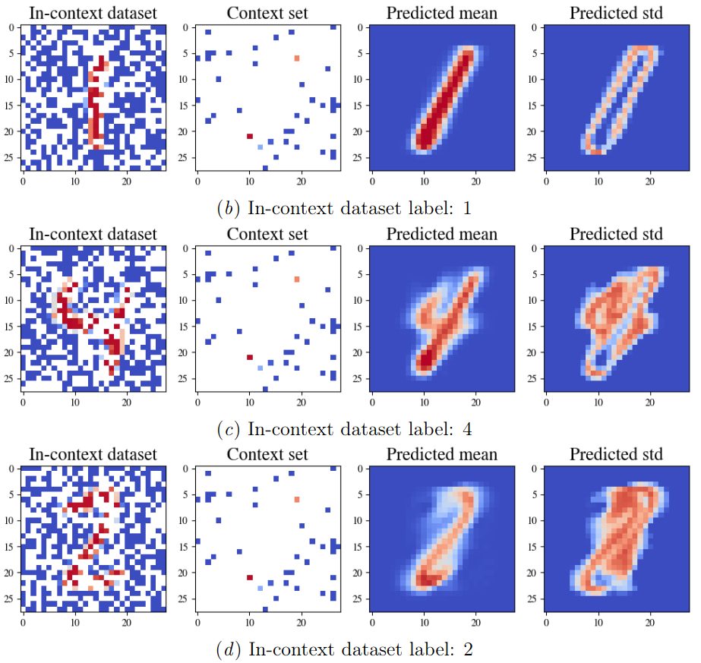
MNIST Image Completion
(Notice high uncertainty for 4 and 2, where the context set is less compatible with the label of the in-context dataset.)

Slide 59
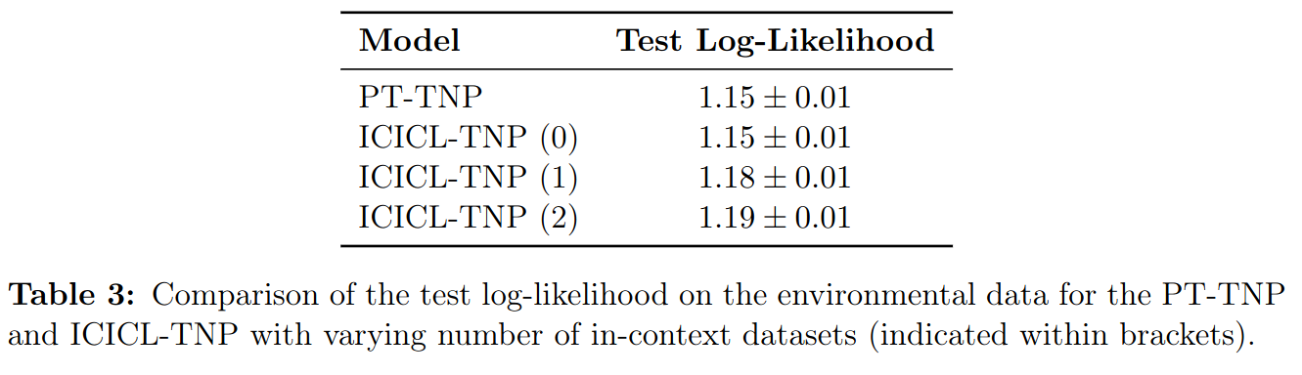
Environmental Data
Regression on spatio-temporal data for surface air temperature.
In-context datasets are obtained from the same location but at different times.

Slide 60
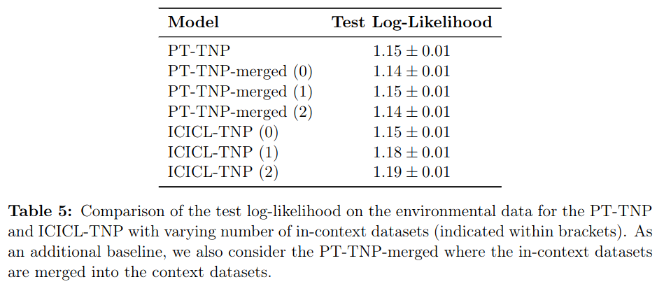
Environmental Data
Another baseline: also allow PT-TNP to train on the in-context sets (but just stick that data in with the main context).
(This doesn’t help.)

Slide 61
Weaknesses
More experiments?
Larger-scaled
(Though the experiments in this paper seem to match standard experiments in other NP papers…)
Include the PT-TNP-merged baseline in all experiments.
(Or some other method to let PT-TNP use the in-context data, even if badly.)
ICICL relies on identifying in-context datasets drawn from the same stochastic process as the context dataset. This is often not possible.

Slide 62
References
Ashman, Matthew, et al. "In-Context In-Context Learning with Transformer Neural Processes." arXiv preprint arXiv:2406.13493 (2024).
Nguyen, Tung, and Aditya Grover. "Transformer neural processes: Uncertainty-aware meta learning via sequence modeling." arXiv preprint arXiv:2207.04179 (2022).
Foong, Andrew, et al. "Meta-learning stationary stochastic process prediction with convolutional neural processes." Advances in Neural Information Processing Systems 33 (2020): 8284-8295.
Lee, Juho, et al. "Set transformer: A framework for attention-based permutation-invariant neural networks." International conference on machine learning. PMLR, 2019.
Kim, Hyunjik, et al. "Attentive neural processes." arXiv preprint arXiv:1901.05761 (2019).
Garnelo, Marta, et al. "Conditional neural processes." International conference on machine learning. PMLR, 2018.

Slide 63
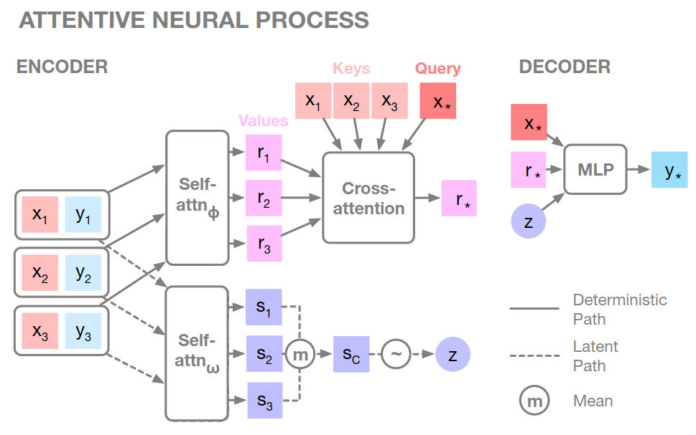
Appendix: Attentive Neural Process (ANP)

